Slide 1


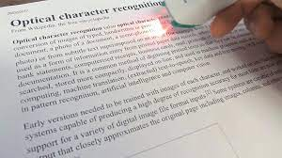
Text Detection and Recognition (OCR with Otsu’s Binarization and Hough Transform)
Course: Computer Vision
Course Code: CSE3010
Slot(s): B11+B12
Class No: BL2022231000528
(Fall Semester 2022’23)

Slide 2

Team of Presenter(s):
Dharna Prakash (20BAC10001)
Jenish Murdia (20BAC10004)
Lakshya Kumar Sirohi (20BAC10014)
Varun Ram S (20BAC10038)
Oishi Basak (20BAI10092)

Slide 3
ACKNOWLEDGEMENT
We would like to thank our Professor Dr. Susant Kumar Panigrahi for giving us an opportunity to make a presentation+project on the topic “Text Recognition and recognition”.
Making this presentation helped us in learning better about different areas of Computer Vision and also gave us awareness on topic better when it was looked upon from multiple sources. This presentation also gave us members an opportunity to interact with each other in a healthy way and also to coordinate and work together.

Slide 4

TABLE OF CONTENT(s):
What is OCR
Applications of OCR
Basics of Hough Transform
Otsu's Method
Project: Text Detection and Recognition (using Hough transform and Otsu's Binarization)

Slide 5
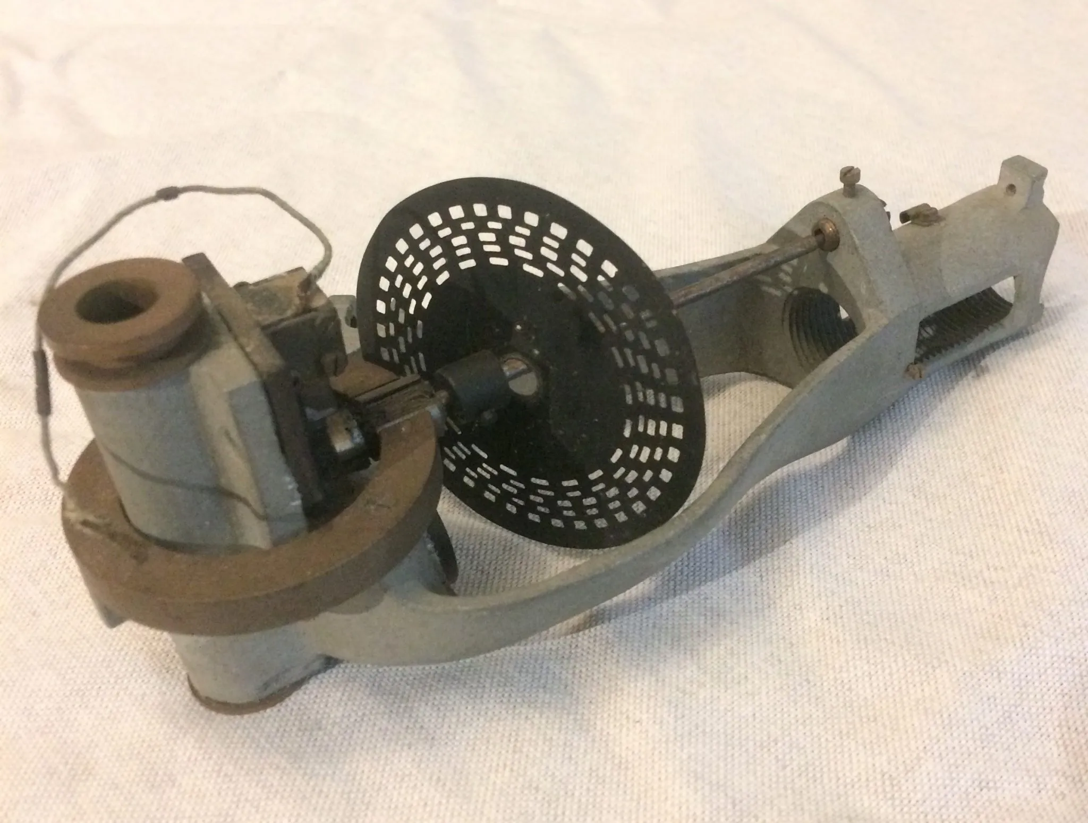
What is OCR?
Stands for Optical Character Recognition
Began back in 1913 when Dr. Edmund Fournier d’Albe invented the Optophone for visually impaired people
Main objectives: pre-processing of the image, character recognition, and post-processing the specific output.
Downstream tasks of OCR include Natural Language Processing (NLP) to not only read but also analyze and understand the meaning of text and speech
Fig: Optophone

Slide 6

ALGORITHM IN A NUTSHELL:
Scanning Document/text
Refining the image
Binarization
Recognising the characters
Verifying the accuracy

Slide 7
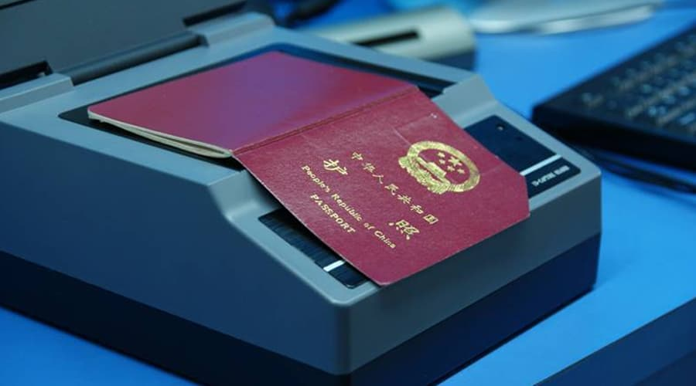
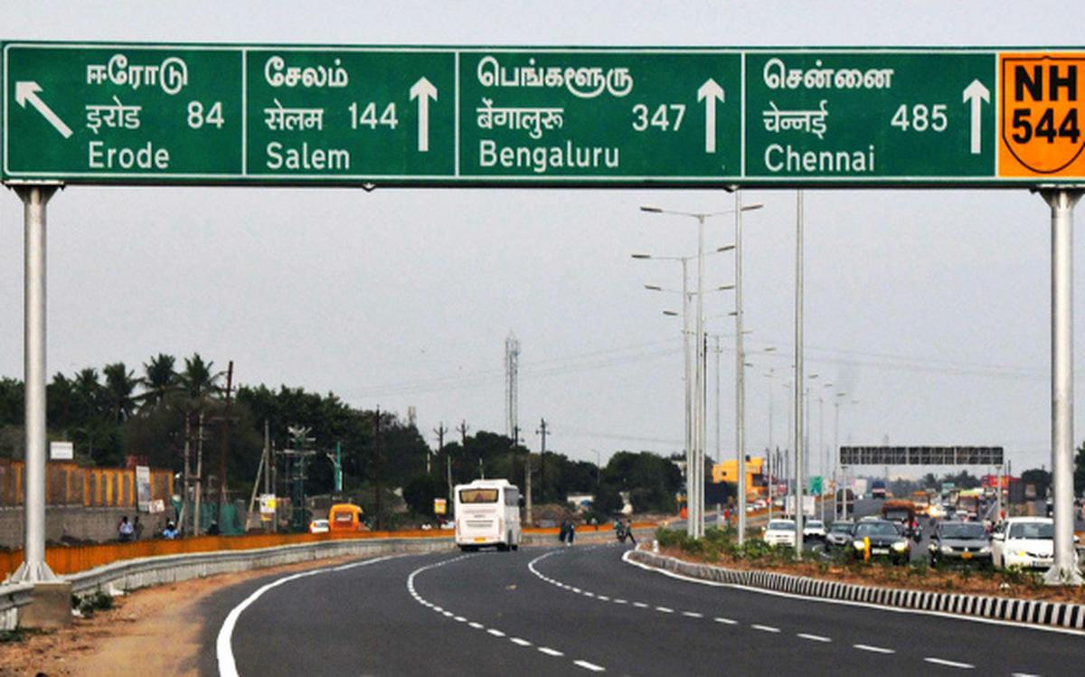
Applications of OCR
Passport recognition for airports
Highway direction board recognition
Extracting contact information from documents or business cards
Converting handwritten notes to machine-readable text
Defeating CAPTCHA anti-bot systems

Slide 8
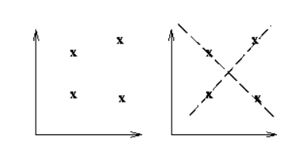
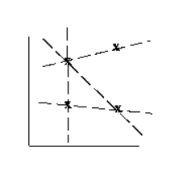

Basics of Hough Transform
The Hough transform is a technique which can be used to isolate features of a particular shape within an image.
Because it requires that the desired features be specified in some parametric form, the classical Hough transform is most commonly used for the detection of regular curves such as lines, circles, ellipses, etc.
A generalized Hough transform can be employed in applications where a simple analytic description of a feature(s) is not possible

Slide 9

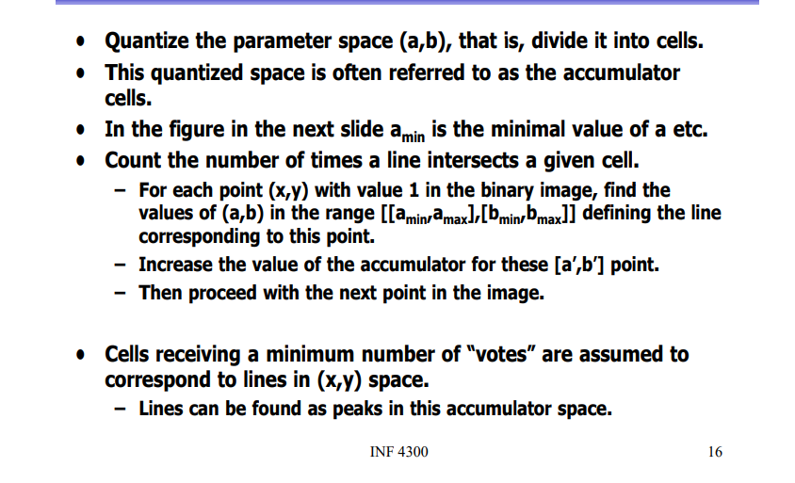

.
ALGORITHM:

Slide 10
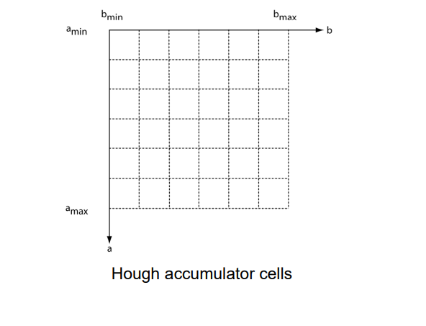
FIGURE FOR REFERENCE OF PREVIOUS SLIDE:

Slide 11
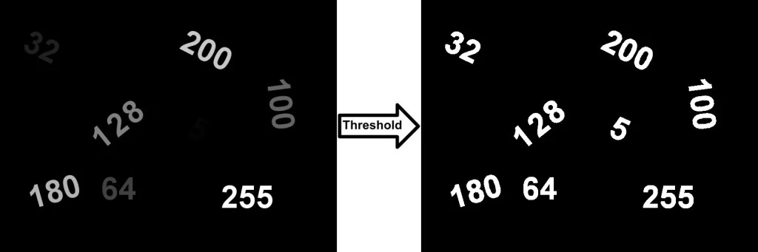
Otsu's Binarization
Let’s understand, what is Binarization first!
Binarization generally involves two steps including:
The determination of a gray threshold according to some objective criteria.
Assigning each pixel to one class of background or foreground.
If the intensity of the pixel is greater than the determined threshold then it belongs to the foreground class and otherwise to the background. The main problem in binarization is the choice of thresholding technique.
Thresholding is an efficient technique in binarization. The choice of thresholding technique is crucial in binarization. There are various thresholding algorithms have been proposed to define the optimal threshold value and one of them being Otsu’s method.

Slide 12
Otsu’s Method
Otsu’s thresholding technique is a classification-based method which searches for the threshold that minimizes the intra-class variance, defined as a weighted sum of variances of the two classes.
Otsu’s algorithms simply assume that a grayscale image consists of two types of pixels. Foreground and background pixels. It divides all the pixels into two clusters.
It minimises the intra-cluster variation by maximising the inter-cluster variance.
Finally, it returns a single intensity value which is called a threshold value. This threshold value divides the two clusters of pixels.
All pixels of one cluster are assigned intensity value 0 and pixels of the second clusterr are assigned value 1. Thus, it binarises the grayscale image.

Slide 13
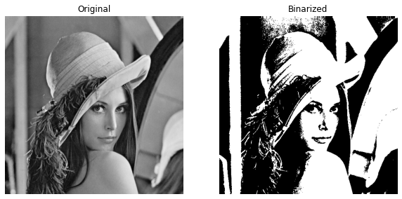
Steps Involved in Otsu’s Binarization:
Read the coloured image.
Convert it into a grayscale image.
Apply Otsu’s thresholding function.
Convert grayscale image into a binary image using a threshold.
Display the binary image.
Binarize the grayscale image using the local otsu’s method.
Display the image.

Slide 14
Project: Text Detection and Recognition (using Hough transform and Otsu’s Binarization)
Abstract: OCR or Optical Character recognition is one of the most useful applications of Computer Vision where we can apply image processing techniques to extract characters from a real life object or paper and get it stored in our computer to display as output or work with it. There are multiple ways to implement the same, and the appropriate algorithm is chosen based on the Requirement. In this Project, a OC Recognition system using Hough transform and Otsu’s Binarization has been made.

Slide 15

.
.

Slide 16

.
.

Slide 17
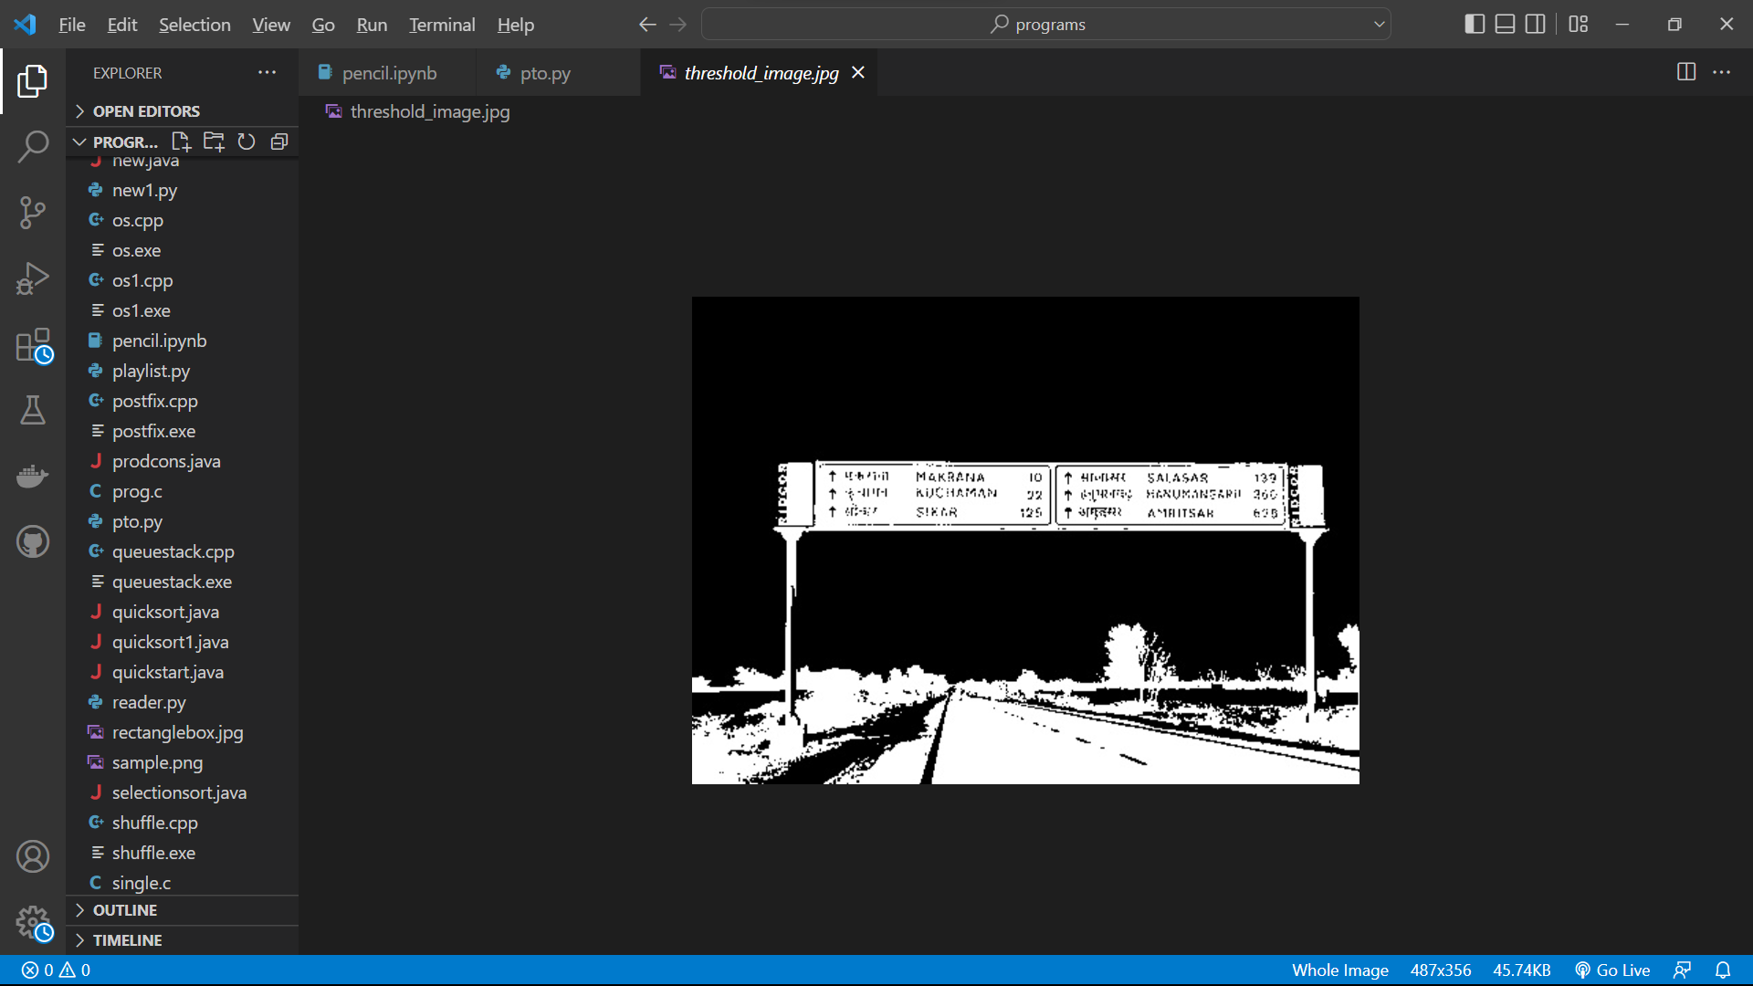
.
.

Slide 18
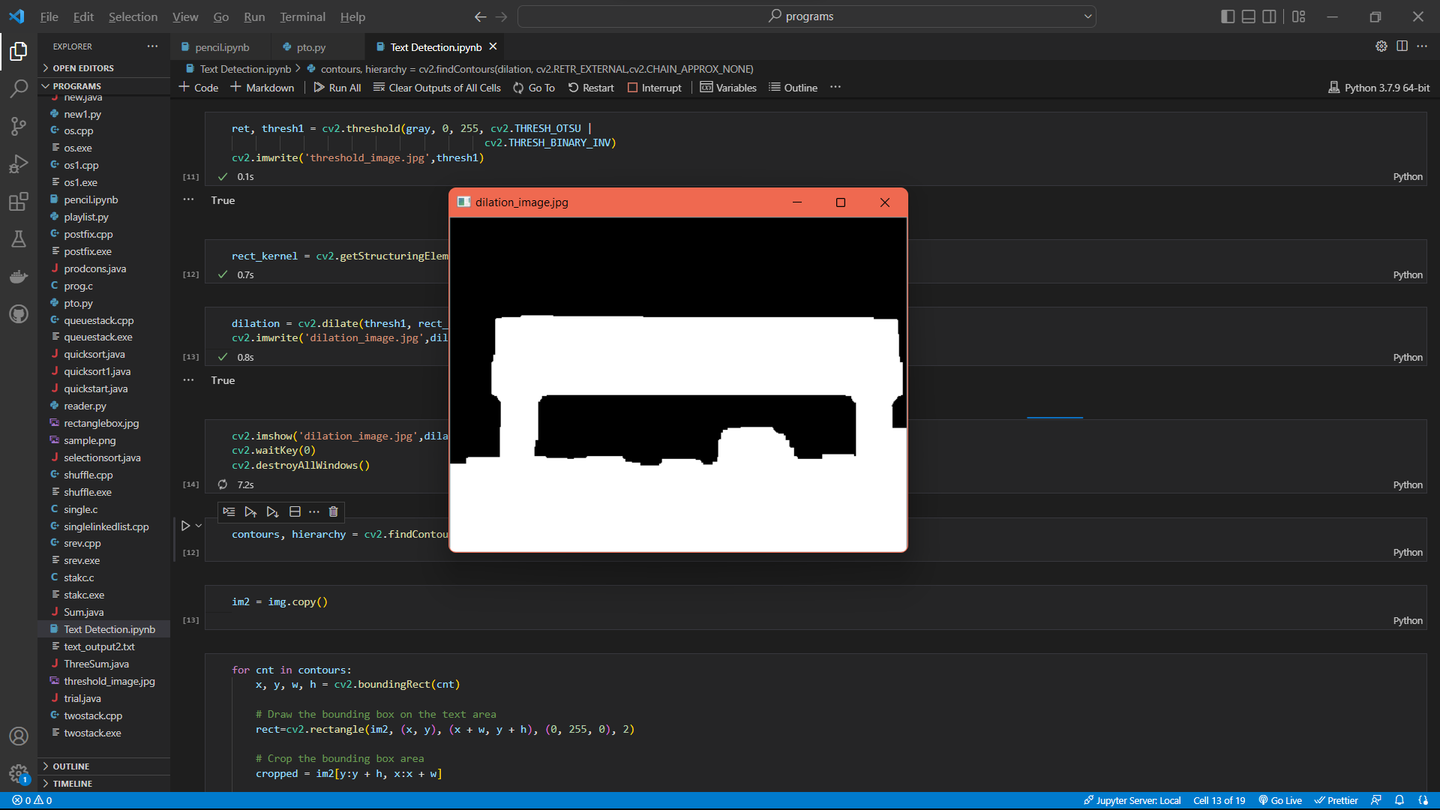
.
.

Slide 19
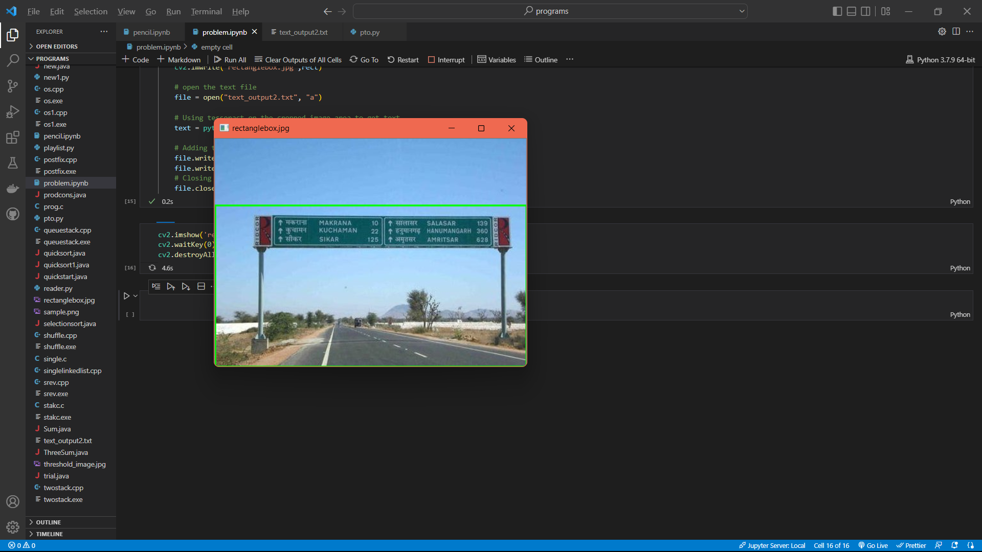
.
.

Slide 20
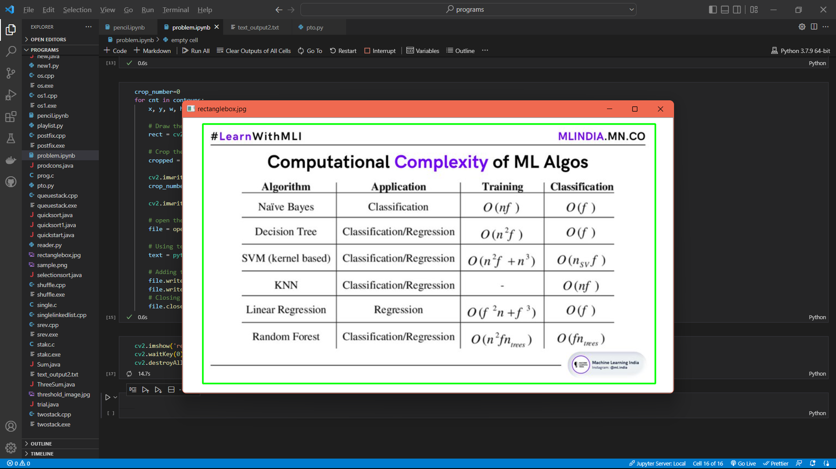
.
.

Slide 21
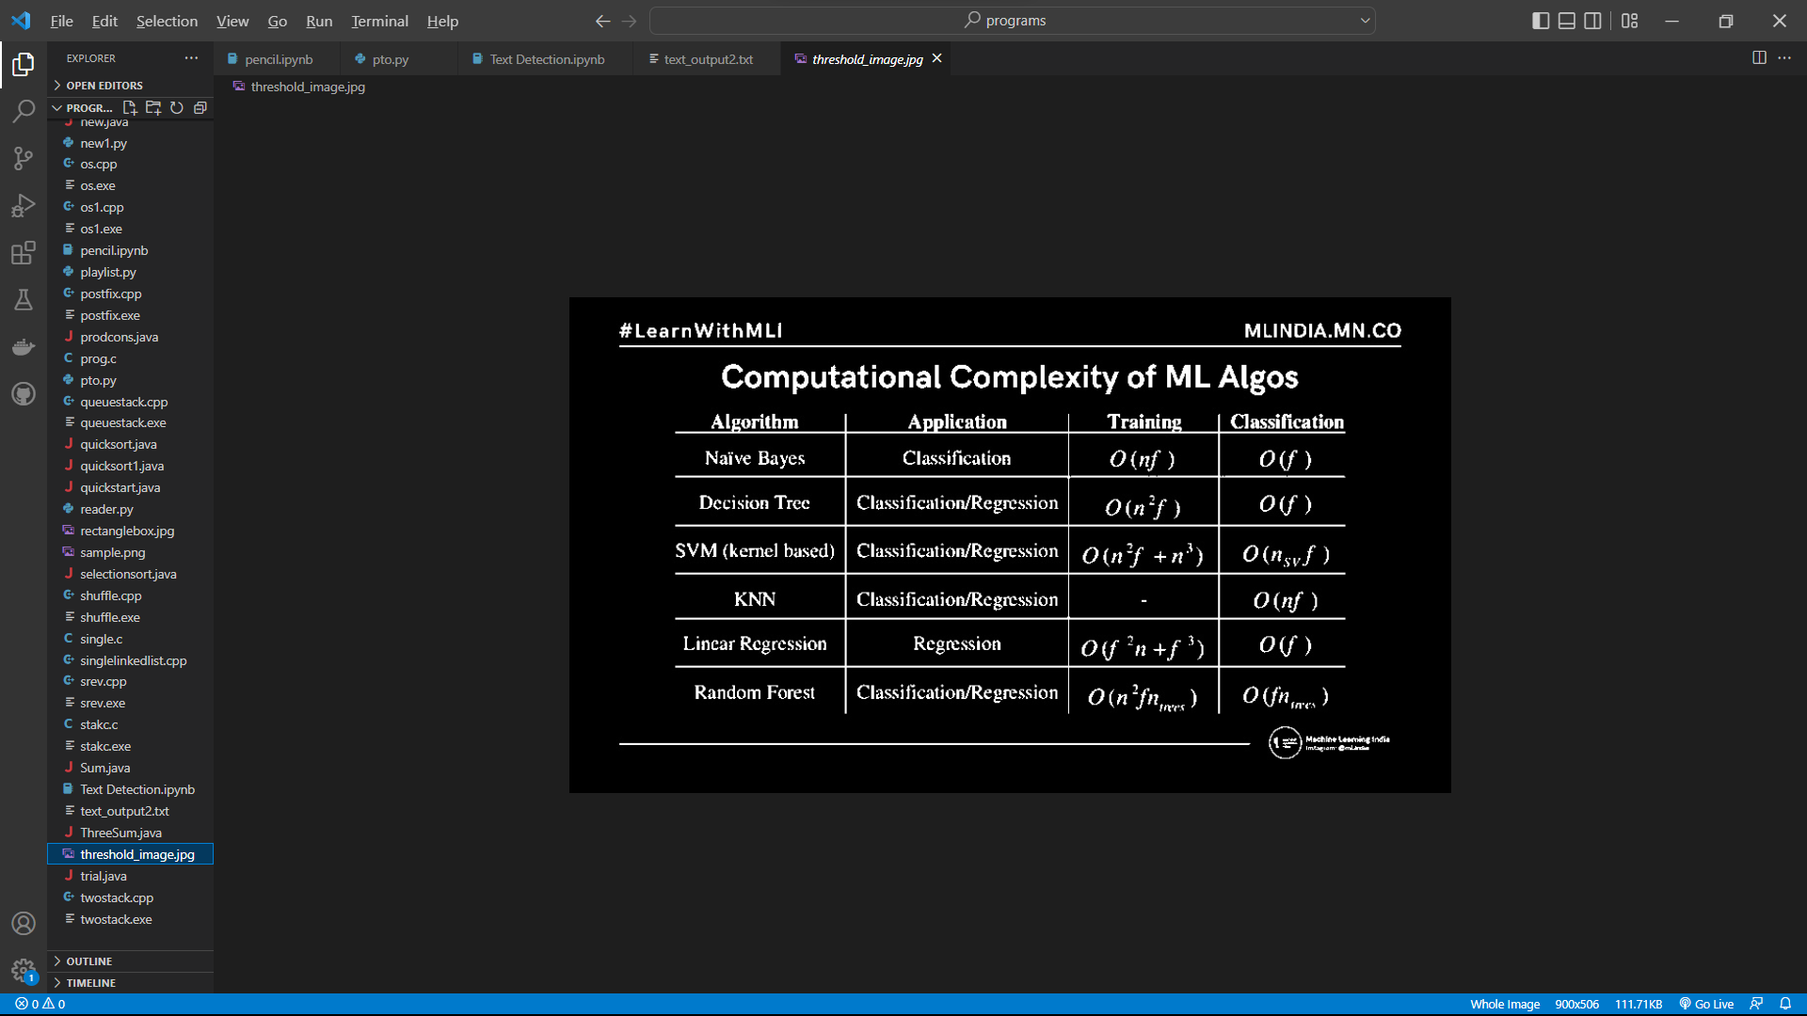

Slide 22
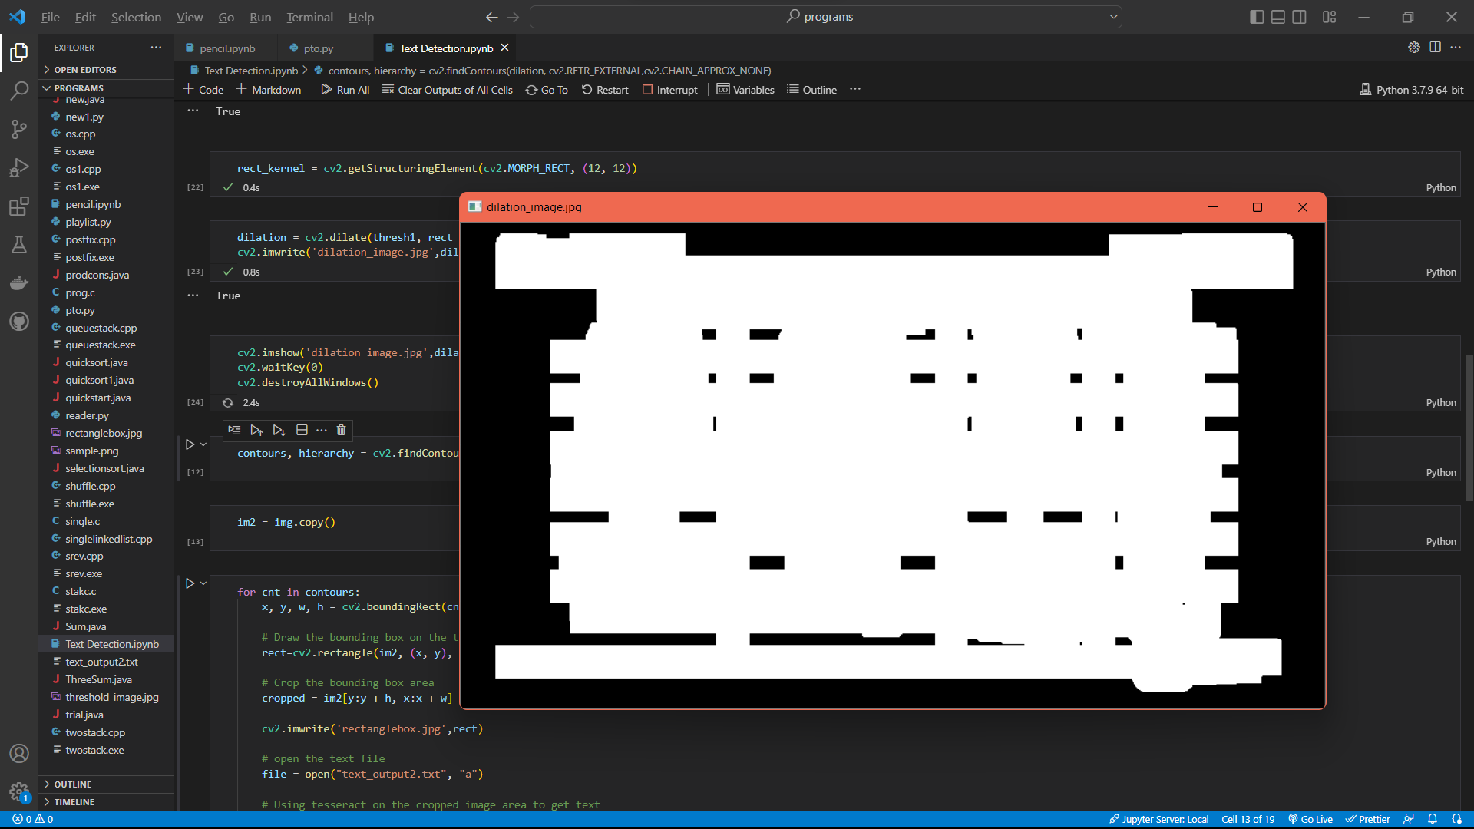
.
.

Slide 23

.
.

Slide 24
BIBLIOGRAPHY AND REFERENCE(S):
Textbook(s):
Learn Computer Vision Using OpenCV With Deep Learning CNNs and RNNs - Sunila Gollapudi
Natural Language Processing Recipes Unlocking Text Data with Machine Learning and Deep Learning using Python - Akshay Kulkarni, Adarsha Shivananda
Website(s):
https://homepages.inf.ed.ac.uk/rbf/HIPR2/hough.htm
https://towardsdatascience.com/lines-detection-with-hough-transform-84020b3b1549
https://viso.ai/

Slide 25
THANK YOU!!!

